Slide 1
Module 2
Engineering Design Approaches

Slide 2
What is design?
To design is to pull together something new or to arrange existing things in a new way to satisfy a recognized need of society.
The ability to design is both a science and an art.
Design should not be confused with discovery. We can discover what has already existed but has not been known before, but a design is the product of planning and work.
Design may or may not involve invention.

Slide 3
Design: Analysis and Synthesis
Good design requires both analysis and synthesis.
Typically we approach complex problems like design by decomposing the problem into manageable parts. Because we need to understand how the part will perform in service, we must be able to calculate as much about the part’s expected behavior as possible before it exists in physical form by using the appropriate disciplines of science and engineering science and the necessary computational tools.
Synthesis involves the identification of the design elements that will comprise the product, its decomposition into parts, and the combination of the part solutions into a total workable system.

Slide 4
The Four C’s of Design
Creativity
Requires creation of something that has not existed before or has not existed in the designer’s mind before.
Complexity
Requires decisions on many variables and parameters.
Choice
Requires making choices between many possible solutions at all levels, from basic concepts to the smallest detail of shape.
Compromise
Requires balancing multiple and sometimes conflicting requirements.

Slide 5
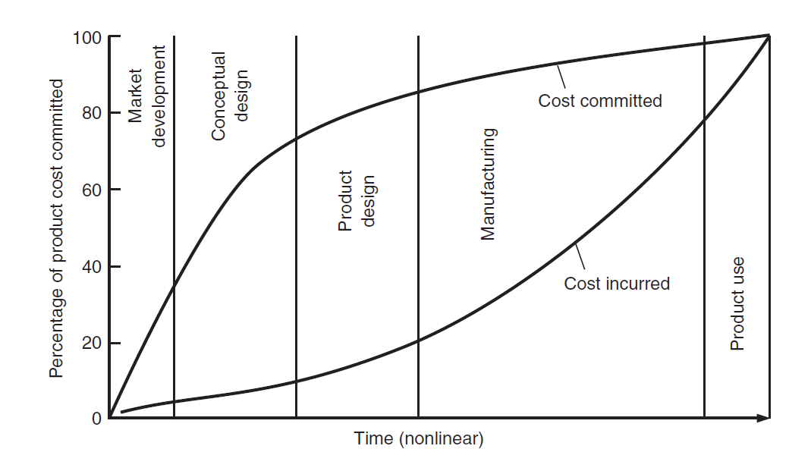
Importance of the Engineering Design Process
Cost of design
Product quality
Product cycle time
The design process should be
conducted so as to develop
quality, cost-competitive products
in the shortest time possible.

Slide 6
Types of Designs
Original design
This form of design is at the top of the hierarchy. It employs an original, innovative
concept to achieve a need. Sometimes but rarely, the need itself may be original.
A truly original design involve invention. Example is steam engine.
Adaptive design
This form of design occurs when the design team adapts a known solution to
satisfy a different need to produce a novel application.
Redesign
To modify shape of existing design, working principle is same.
Selection design
To modify the parts used in machine

Slide 7
A Problem-Solving Methodology
Designing can be approached as a problem to be solved. A problem-solving methodology that is useful in design consists of the following steps
Definition of the problem
Gathering of information
Generation of alternative solutions
Evaluation of alternatives and decision making
Communication of the results

Slide 8
Definition of the problem
The most critical step in the solution of a problem is the problem definition or
formulation.
The formulation of the problem should start by writing down a problem statement. This document should express as specifically as possible what the problem is.
It should include objectives and goals, the current state of affairs and the desired state, any constraints placed on solution of the problem, and the definition of any special technical terms
Problem definition often needs analysis

Slide 9
Gathering of information
Textbooks and articles published in the scholarly technical journals usually are of lesser importance. The need often is for more specific and current information than is provided by those sources.
Technical reports published as a result of government-sponsored R&D, company reports, trade journals, patents, catalogs, and handbooks and literature published by vendors and suppliers of material and equipment are important sources of information.
The Internet is a very useful resource
Discussions with in-house experts (often in the corporate R&D center) and outside consultants may prove helpful

Slide 10
The following are some of the questions concerned with obtaining information
What do I need to find out?
Where can I find it and how can I get it?
How credible and accurate is the information?
How should the information be interpreted for my specific need?
When do I have enough information?
What decisions result from the information?

Slide 11
Generation of Alternative Solutions
Generating alternative solutions or design concepts involves the use of creativity stimulation methods, the application of physical principles and qualitative reasoning, and the ability to find and use information.
The ability to generate high-quality alternative solutions is vital to a successful design.
Evaluation of Alternatives and Decision Making
Engineering analysis procedures
Simulation of performance with computer models
Mathematical checks and engineering-sense checks
Robust design that is resistant to environmental influences (water vapor, temperature, vibration, etc.)

Slide 12
Communications of the results
Satisfy the needs of a customer or client
Detailed engineering drawings, computer programs, 3-D computer models, and working models

Slide 13
Design-Social and Professional context

Slide 14
Design-Social and Professional context
Social - Design to solve social issue or need
Ex- Devices for Handicapped
Better housing
Better sanitation
Clean drinking water
Abundant food
Educational help
Note: Unsocial designs degrade the quality of life

Slide 15
Continue….
Professional - Design focused on comfortability, ease to
access or technological advancement
Ex- E-Newspaper
Business class in aircraft
Electric bicycles
Wireless charger
Headphones/wireless headphones
Sensors watertap

Slide 16
Different Phases of Design Process
Three Major Phases
1. Conceptual Design
2. Embodiment Design
3. Detailed Design

Slide 17
Phase I. Conceptual Design
Conceptual design is the process by which the design is initiated, carried to the point of creating a number of possible solutions, and narrowed down to a single best concept.
It is sometimes called the feasibility study
Identification of customer needs
The goal of this activity is to completely understand the customers needs and to communicate them to the design team.
Problem definition
Quality function deployment (QFD) is a valuable tool for linking customer needs with design requirements.
A detailed listing of the product requirements is called a product design specification (PDS).

Slide 18
Gathering information
Engineering design presents special requirements over engineering research in the need to acquire a broad spectrum of information
Conceptualization
Concept generation involves creating a broad set of concepts that potentially satisfy the problem statement. Team-based creativity methods, combined with efficient information gathering, are the key activities
Concept selection
Evaluation of the design concepts, modifying and evolving into a single preferred concept, are the activities in this step
Refinement of the PDS
The product design specification is revisited after the concept has been selected. The design team must commit to achieving certain critical values of design parameters, usually called critical-to-quality (CTQ) parameters

Slide 19
Design review
Before committing funds to move to the next design phase, a design review
will be held.
The design review will assure that the design is physically realizable
and that it is economically worthwhile.
It will also look at a detailed product-development schedule.
This is needed to devise a strategy to minimize product cycle time and to identify
the resources in people, equipment, and money needed to complete the project.

Slide 20
Phase II. Embodiment Design
Structured development of the design concept occurs in this engineering design
phase.
It is the place where flesh is placed on the skeleton of the design concept.
It is in this design phase that decisions are made on strength, material selection, size, shape, and spatial compatibility.
Beyond this design phase, major changes become very expensive.
Determining product architecture
Product architecture is concerned with dividing the overall design system into subsystems or modules. In this step we decide how the physical components of the design are to be arranged and combined to carry out the functional duties of the design

Slide 21
Configuration design of parts and components
Parts are made up of features like holes, ribs, splines, and curves
Preliminary selection of materials, modeling and size of parts
Parametric design of parts
Creating a robust design, and selection of final dimensions/parameters and tolerances
Parametric design starts with information on the configuration of the part and aims to establish its exact dimensions and tolerances
Final decisions on the material and manufacturing processes are also established
if this has not been done previously
Robustness refers to how consistently a component performs under variable conditions in its service environment
Parametric design also deals with determining the aspects of the design that could lead to failure
Reduction of manufacturing cost

Slide 22
Phase III. Detail Design
In this phase the design is brought to the stage of a complete engineering description of a tested and producible product.
Missing information is added on the arrangement, form, dimensions, tolerances, surface properties, materials, and manufacturing processes of each part
Detailed engineering drawings suitable for manufacturing. Routinely these are
computer-generated drawings, and they often include three-dimensional CAD models
Verification testing of prototypes is successfully completed and verification data is submitted. All critical-to-quality parameters are confirmed to be under control.
Creation of final drawings and/or specifications
Assembly drawings and assembly instructions also will be completed. The bill of materials for all assemblies will be completed

Slide 23
Continue…
A detailed product specification, updated with all the changes made since the conceptual design phase, will be prepared.
Decisions on whether to make each part internally or to buy from an external supplier will be made
With the preceding information, a detailed cost estimate for the product will be carried out
Finally, detail design concludes with a design review before the decision is made to pass the design information on to manufacturing

Slide 24
Identification and Specifications

Slide 25
Need Identification and Specification
For design process, we require need and specification
Needs arise from a number of sources including:
Incremental improvements to existing designs
Replacements for existing designs
Categories of Needs:
(1) Minimum needs ==> Are the new features that the customers consider important
Ex. For car this would mean seating and dashboard electronics
(2) Assumed needs ==> It includes basic operation, safety and reliability.
Ex. For a car this would mean the ability to drive
(3) Unrecognized needs ==> Ex. . For a car this would mean sounds, AC, voltage requirement

Slide 26
Design objectives and functional requirements are what the design should strive
for. It is best to define the ideal and acceptable values
Examples of well-defined objectives include the following:
Cost between $100.00 and $120.00
Provide a maximum power from 50 to 75 KW
A maximum speed of 100 to 150 m/s
Heating time between 40 and 60 s
Design constraints are firm limits that must be met for the design to be acceptable. Examples of these are listed below
Must be delivered by June 15
Surface temperature below 50°C
Cycle times below 3 seconds
Power levels above 5 W

Slide 27
Specifications
A specific description of design and materials used to make something
They are set of instructions or requirements given in codes and standards
Must meet requirements of customers
Example-Company provided specification, Product design specifications
Requirements of specifications
Specifications provide specific/ additional requirements for materials,
components based on codes and standards
Often generated by companies to address additional requirements applicable
to a specific products or application

Slide 28
Conversion of needs to specification
When converting needs to specification, approaches to consider include the following
Find similar designs from the past, present, or future.
Examine each of the objectives and constraints and find methods for implementation.
Identify components
Meeting with customers, users, or others
Perform benchmarking with competitive designs
Identify technologically challenging features, e.g., Is it new? Have others used it? For how long?

Slide 29
Failure to adhere to the specifications results in feature creep, a common and critical problem that occurs when specifications are poorly written or don’t exist. After this phase the addition or change of any specification will result in delays and increased costs
Specification to build a robot
cost $6.25
two motors and rubber tires
tank steering
traces your logo but avoids the walls
it has a plastic body with your logo on two sides.
a domed top and round body with a 10-cm diameter

Slide 30
Possible question that may help to explore Specification
1.Is the specification measurable?
2. How will the specification be measured?
3. Are there formal tests that can be used?
4. How will the customer see that the design specifications will be met?
5. How many ways can the specifications be interpreted?
6. What are the failure criteria?
7. Are the numerical values and ranges clear, with units?
8. What are the tolerances?
9. How will acceptance criteria be measured? Safety, usability, etc.
10. How can we manage feature creep?
11. Are there standard tests available for a specification?

Slide 31
Standard and codes

Slide 32
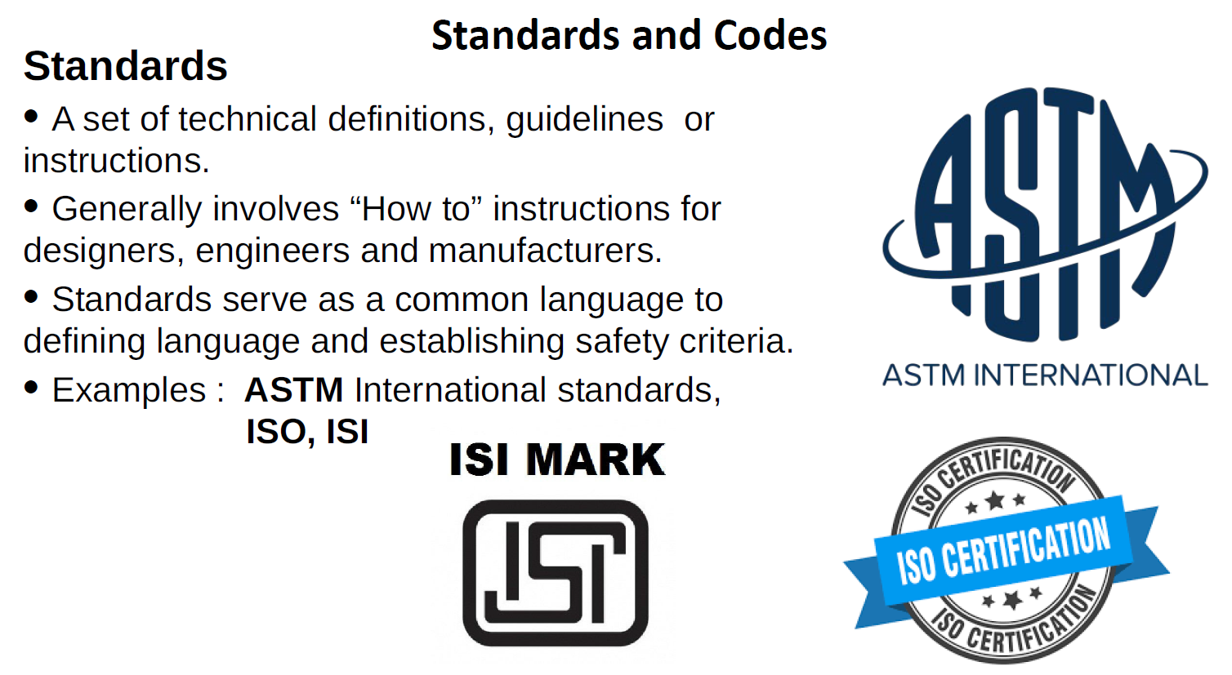
Standards and Codes
ISO- International organization for standardization; ISI- Indian standard institute;
ASTM- American society for testing and materials
ANSI- American national standard institute

Slide 33
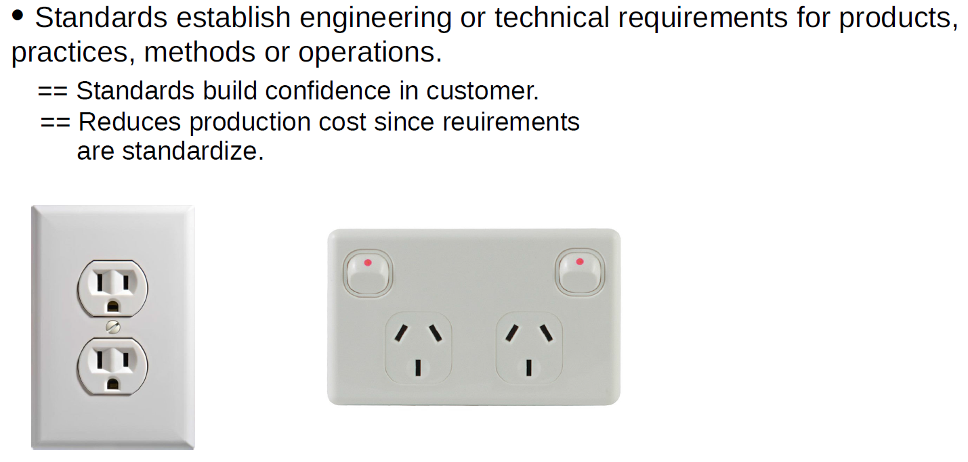
Why Standard is required?

Slide 34
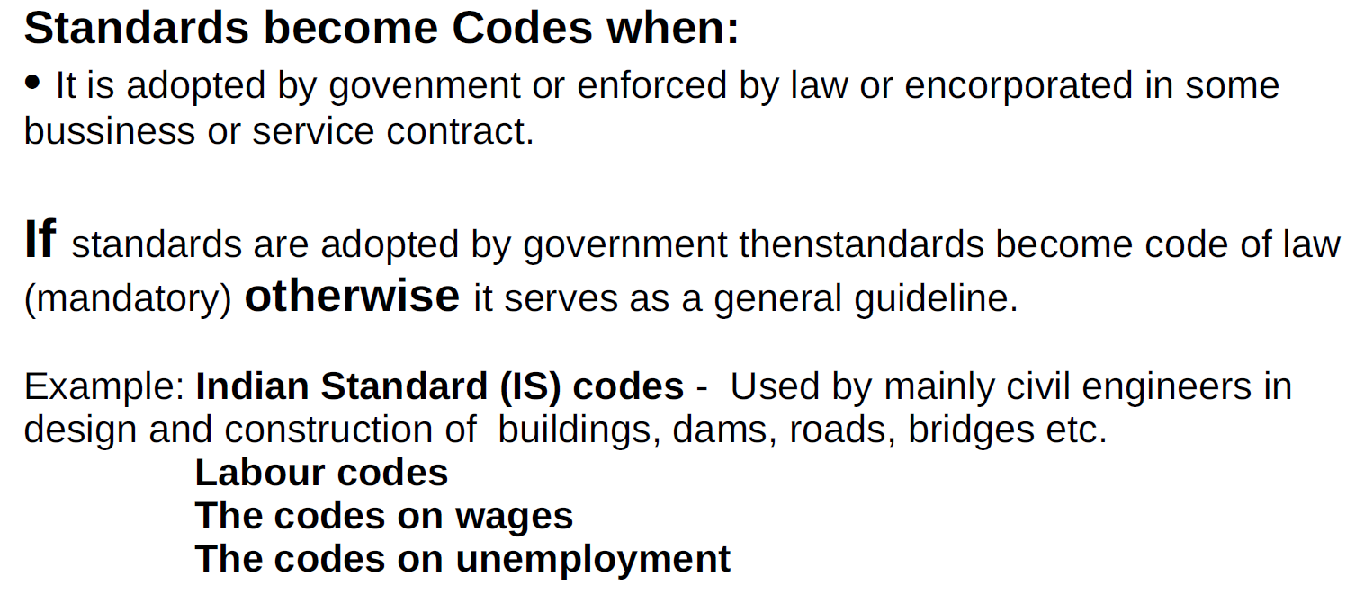
Codes

Slide 35
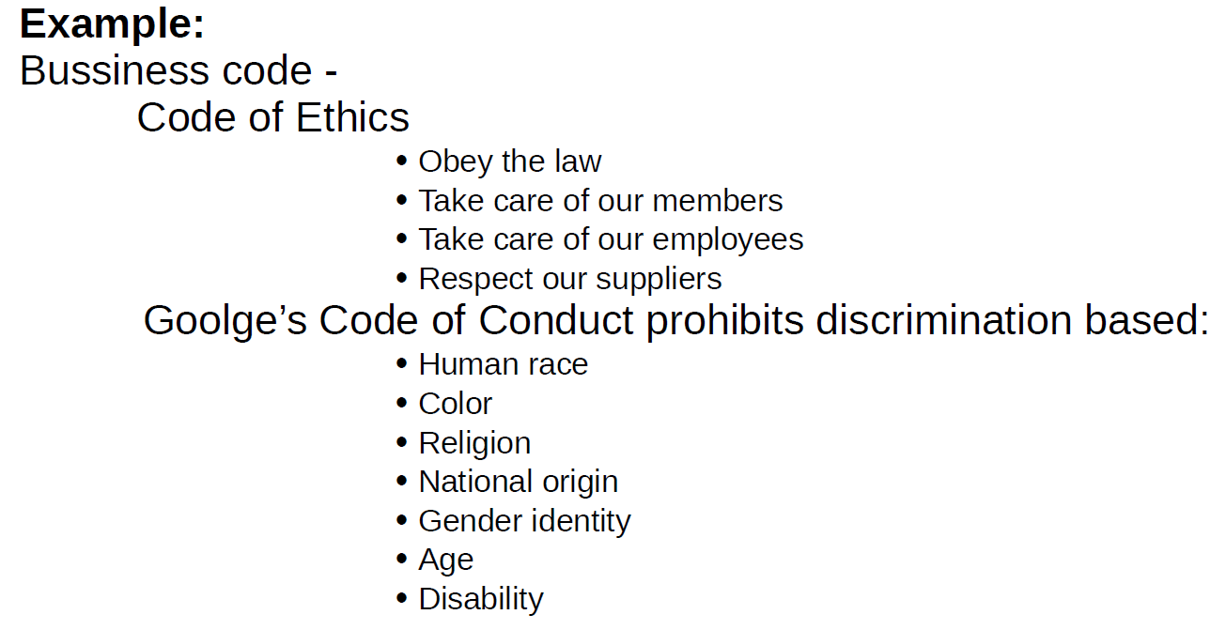

Slide 36

Some important codes

Slide 37
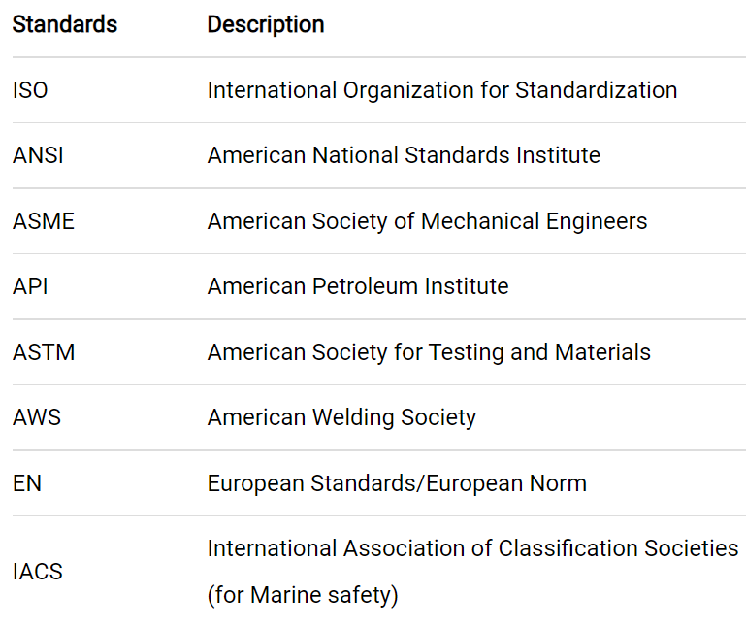
Continue…

Slide 38
Design Features

Slide 39
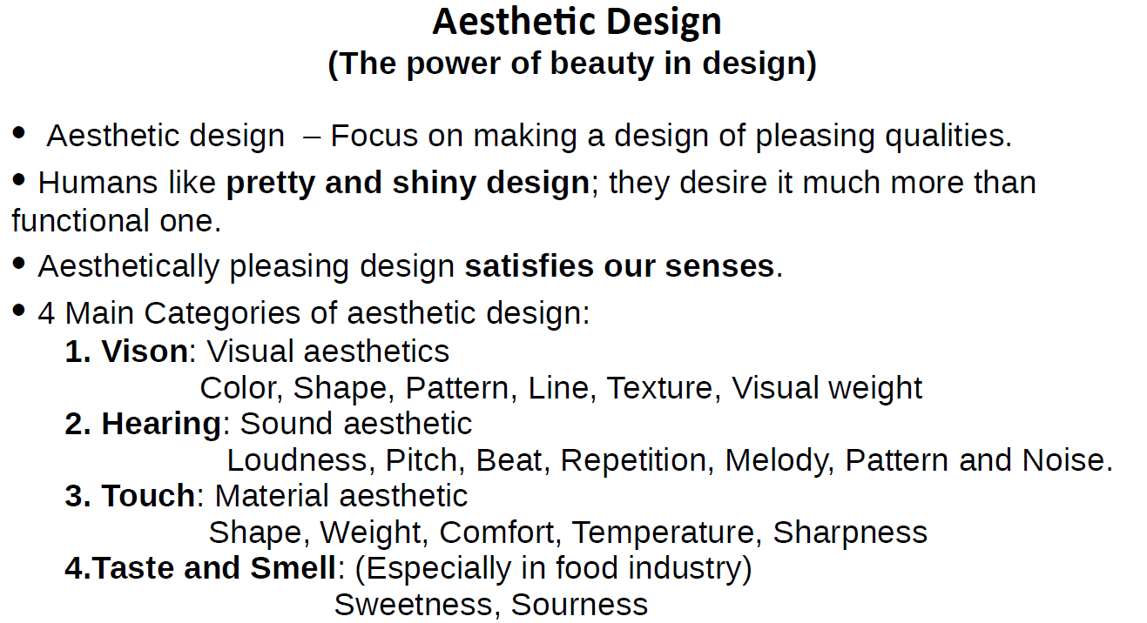

Slide 40
Why aesthetic design matters?
Beautiful products/objects are perceived as easier to use and more valuable than ugly ones. As well close bonding/attachment with design
Aesthetically pleasing designs are bringing up positive attitude in the users. It makes them care more about the product. Aesthetic design makes people more loyal of the brand and tolerant toward mistakes or failures.
Aesthetics and usability in balance
Smart phones that look and feel good, but also have the desired usability
Aesthetics over usability
Some times products have dominating aesthetics that are not supported by good usability and ergonomics. This is mostly visible in the fashion industry.
Shoes made to look nice and attractive, while at the same time destroying the feet of the user
Usability over aesthetics
Equipment designed for emergency situations, where people cognition is compromised

Slide 41
Design for Manufacturing or Production
(DFM)
Design for Manufacturing (DFM) is the process of designing parts, components or products for ease of manufacturing with an end goal of making a better product at a lower cost.
This is done by simplifying, optimizing and refining the product design.
Four principles are examined during a DFM:
Process
The manufacturing process chosen must be the correct one for the part or product.
Design
Design is essential. The actual drawing of the part or product has to conform to good manufacturing principles for the manufacturing process you’ve chosen.

Slide 42
Continue…
Material
It's important to select the correct material for your part/product
Some material properties to consider during DFM include:
Mechanical properties - How strong does the material need to be?
Optical properties - Does the material to be reflective or transparent?
Thermal properties - How heat resistant does it need to be?
Color - What color does the part need to be?
Electrical properties - Does the material need to act as a dielectric (act as an insulator rather than a conductor)?
Flammability - How flame/burn resistant does the material need to be?

Slide 43
Continue…
Environment
Your part/product must be designed to withstand the environment it will be subjected to
Compliance/Testing
All products must comply with safety and quality standards

Slide 44
DFM Guidelines
Minimize total number of parts
Eliminating parts results in great savings. A part that is eliminated costs nothing to make, assemble, move, store, clean, inspect, rework, or service. A part is a good candidate for elimination if there is no need for relative motion, no need for subsequent adjustment between parts, and no need for materials to be different
Standardize components
Costs are minimized and quality is enhanced when standard commercially available components are used in design. The benefits also occur when a company standardizes on a minimum number of part designs (sizes, materials, processes) that are produced internally in its factories
Use common parts across product lines
It is good business sense to use parts in more than one product. Specify the same materials, parts, and subassemblies in each product as much as possible.

Slide 45
Standardize design features
Standardizing on design features like drilled hole sizes, screw thread types, and bend radii minimizes the number of tools that must be maintained in the tool room. This reduces manufacturing overhead cost
Design parts to be multifunctional
A good way to minimize part count is to design such that parts can fulfill more than one function, leading to integral architecture
Minimize secondary and finishing operations
Minimize secondary operations such as heat treatment, machining, and joining and avoid finishing operations such as deburring, painting, plating, and polishing. Machine a surface only when the functionality requires it or if it is needed for aesthetic purposes.
Avoid excessively tight tolerances
Tolerances must be set with great care. Specifying tolerances that are tighter than needed results in increased cost

Slide 46
Design for Standardization
The benefits of standardization occur in four areas: cost reduction, quality improvement, production flexibility
Cost reduction
Purchasing cost
Standardization of parts and the subsequent reduction in part numbers will result in large savings in procurement costs in outsourcing because parts will be bought in larger quantities
Reduce costs through raw material standardization
Cost for in-house production of parts can be reduced if raw materials can be standardized to a single size of bar stock, tubing, and sheet metal
Feature standardization
Standardizing on design features like drilled hole sizes, screw thread types, and bend radii minimizes the number of tools that must be maintained in the tool room. This reduces manufacturing overhead cost

Slide 47
Continue…
Quality improvement
Product quality
Having fewer parts of a given type greatly reduces the chance of using the wrong part in an assembly
Prequalification of parts
The use of standard parts means that there is much greater cumulative experience with using the particular part. This means that standard parts can be prequalified for use in a new product without the requirement for extensive testing
Supplier reduction means improved quality
Standardization of parts means there will be fewer outside suppliers of parts. Those suppliers remaining should be those with a record of producing quality parts

Slide 48
Continue…
Production flexibility
Material logistics
The flow of parts within the plant will be easier with fewer parts to order, receive, stock, issue, assemble, test, and reorder
Parts availability
Fewer part types used in greater volume will mean less chance of running out of parts and delaying production
Quicker supplier deliveries
Standardization of parts and materials should speed up deliveries. Suppliers will have the standard tools and materials in their inventory

Slide 49
Design for safety
A safe product is one that does not cause injury or property loss
Achieving safety is no accident. It comes from a conscious focus on safety during design, and in knowing and following some basic rules
There are three aspects to design for safety:
Make the product safe; that is, design all hazards out of the product.
If it is not possible to make the product inherently safe, then design in protective devices like guards, automatic cutoff switches, and pressure-relief valves, to mitigate the hazard.
If step 2 cannot remove all hazards, then warn the user of the product with appropriate warnings like labels, flashing lights, and loud sounds.
Provide training and protective clothing or devices (glasses, ear mufflers) to the user or operator of the equipment

Slide 50
Design for safety
A fail-safe design
A fail-safe design seeks to ensure that a failure will either not affect the product or change it to a state in which no injury or damage will occur.
There are three variants of fail-safe designs
Fail-passive design
When a failure occurs, the system is reduced to its lowest-energy state, and the product will not operate until corrective action is taken. A circuit breaker is an example of a fail-passive device
Fail-active design
When failure occurs, the system remains energized and in a safe operating mode. A redundant system kept on standby is an example
Fail-operational design
The design is such that the device continues to provide its critical function even though a part has failed. A valve that is designed so that it will remain in the open position if it fails is an example

Slide 51
Design to cost
Design to cost, also called target costing, is the approach in which a target value, (sometimes called “should-cost” data), for the cost of a product is established at the beginning of a product development project.
All design decisions are examined for their impact on keeping below the target cost
The steps in accomplishing design to cost are
Establish a realistic and reliable target cost
The target cost is the difference between a realistic estimate of what the customer will pay for the product when developed minus the expected profit
Divide the target cost into subunits
division according to competitors’ component costs, as determined from dissection of competitor products
on the basis of estimates of what the customer is willing to pay for various functions and features of the product

Slide 52
Oversight of compliance with cost targets
Major difference in the design to cost approach is that the cost projections will be evaluated after each design phase as well as before going into production
Order of Magnitude Estimates
At the very early stage of product development where the market for a new product is being studied, comparison is usually made with similar products already on the market. This gives bounds on the expected selling price.
Products can be divided roughly into three categories
Large functional products—automobile, front-end loader, tractor
Mechanical/electrical—small appliances and electrical equipment
Precision products—cameras, electronic test equipment
Products in each category cost roughly the same on a weight basis

Slide 53
A slightly more sophisticated method is to estimate cost on the basis of the percentage of the share of the total cost that is due to materials cost. For example, about 70 percent of the cost of an automobile is material cost, about 50 percent for a diesel engine, about 25 percent for electrical instruments, and about 7 percent for China dinnerware.
What is the total cost of a diesel engine that weighs 300 lb? The engine is made from ductile iron that costs $2/lb. The material cost share for the engine is 0.5
Cost = (300 $2) /0.5 = $1200

Slide 54
Optimum Design

Slide 55
Optimum Design
Optimum design is a best possible design satisfying certain criteria among many feasible or adequate design
Mathematical, it is similar to finding
a maximum or minimum for a function

Slide 56
Continue…

Slide 57
Continue…

Slide 58
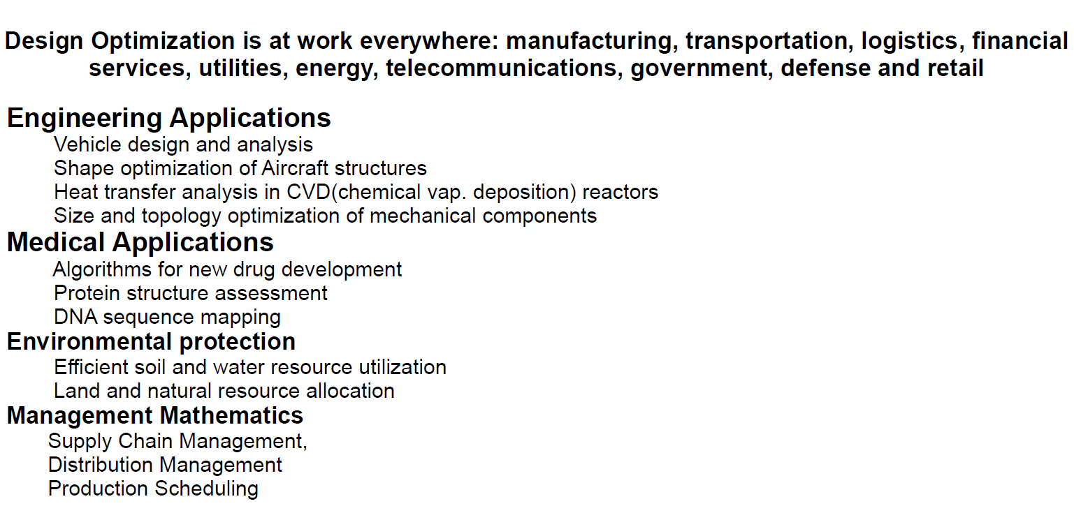
Continue…

Slide 59
Usability

Slide 60
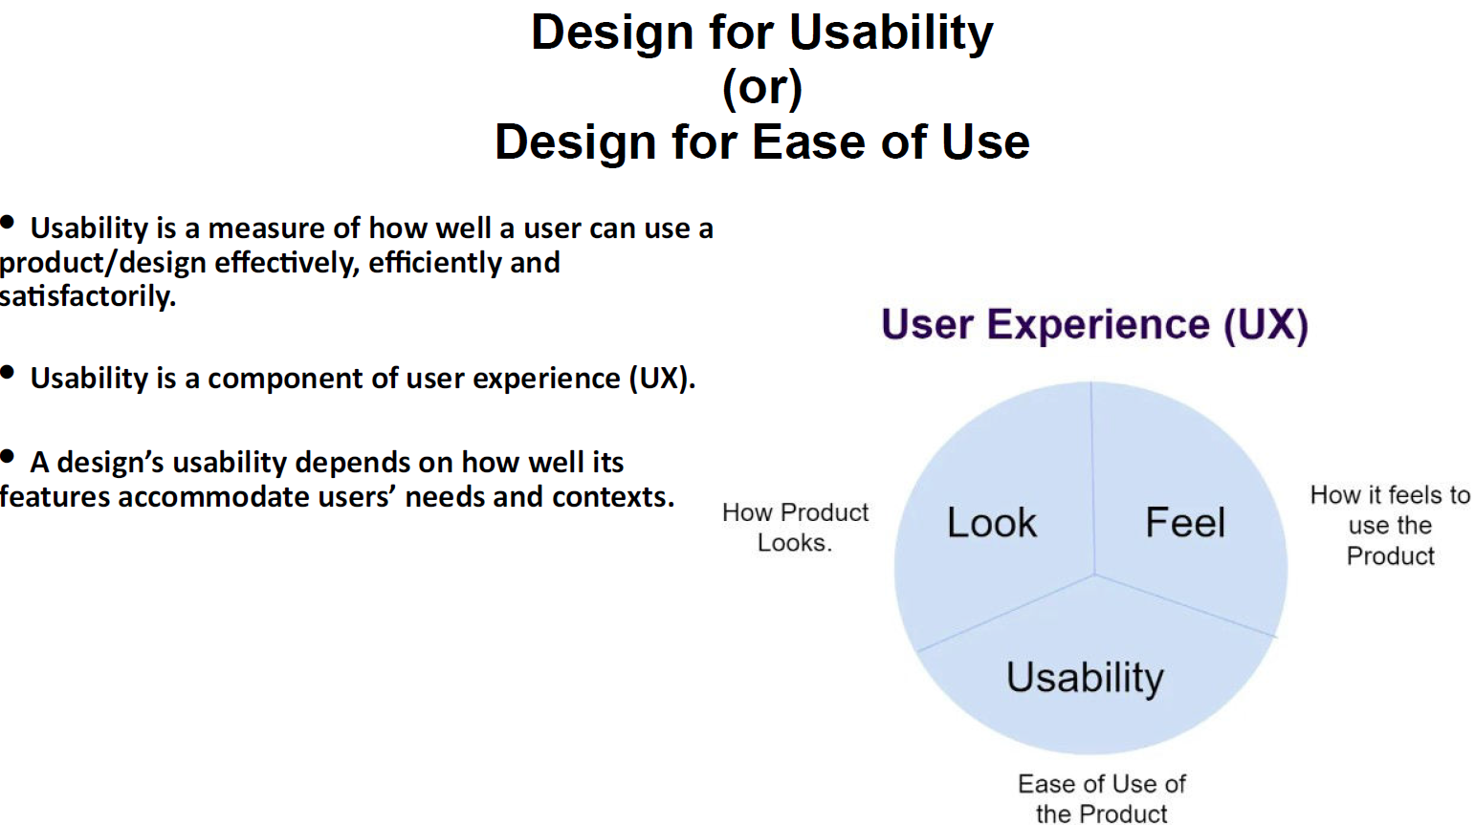

Slide 61
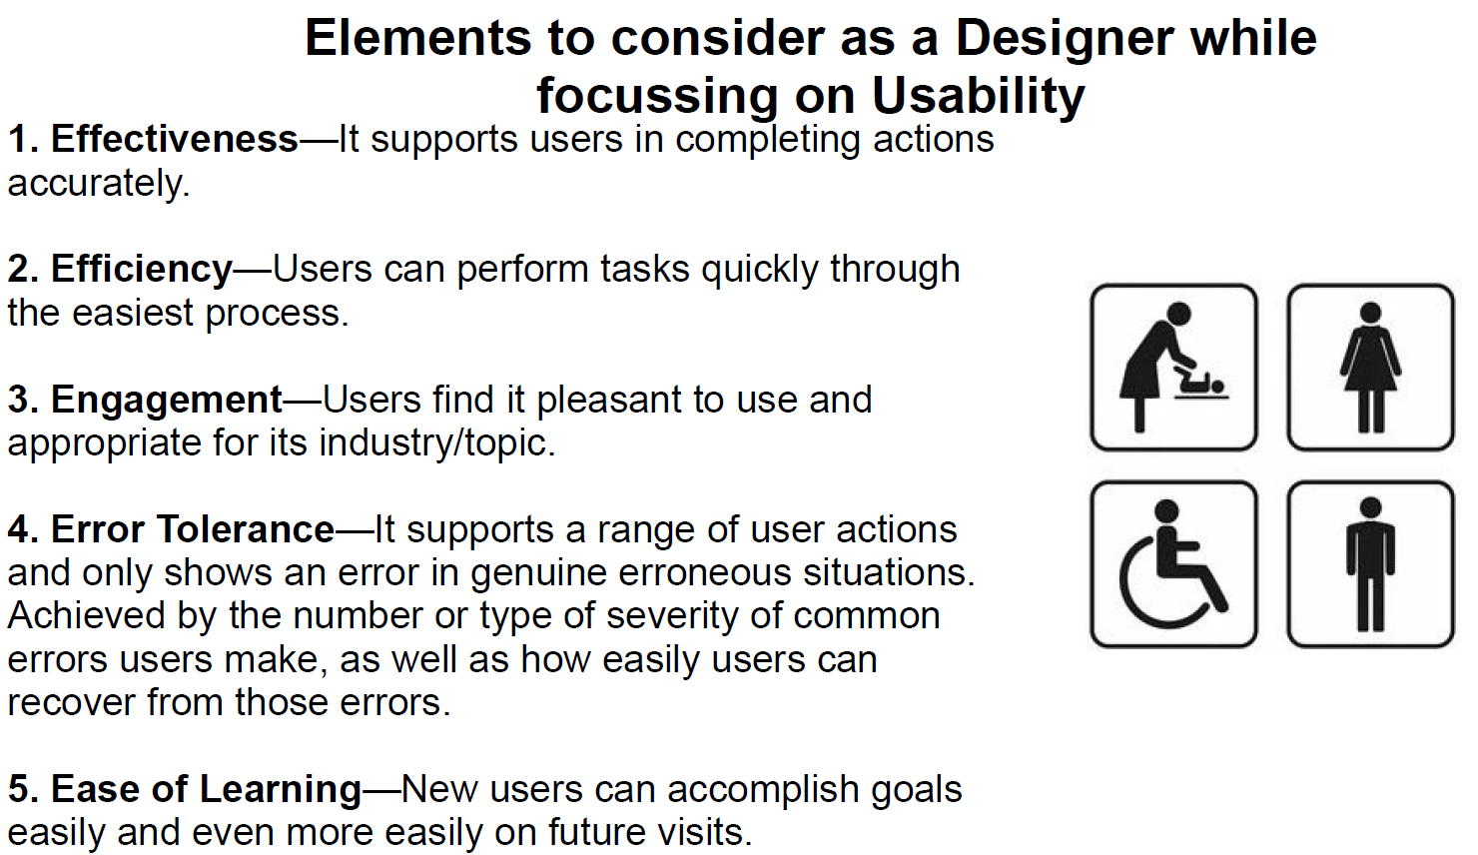

Slide 62
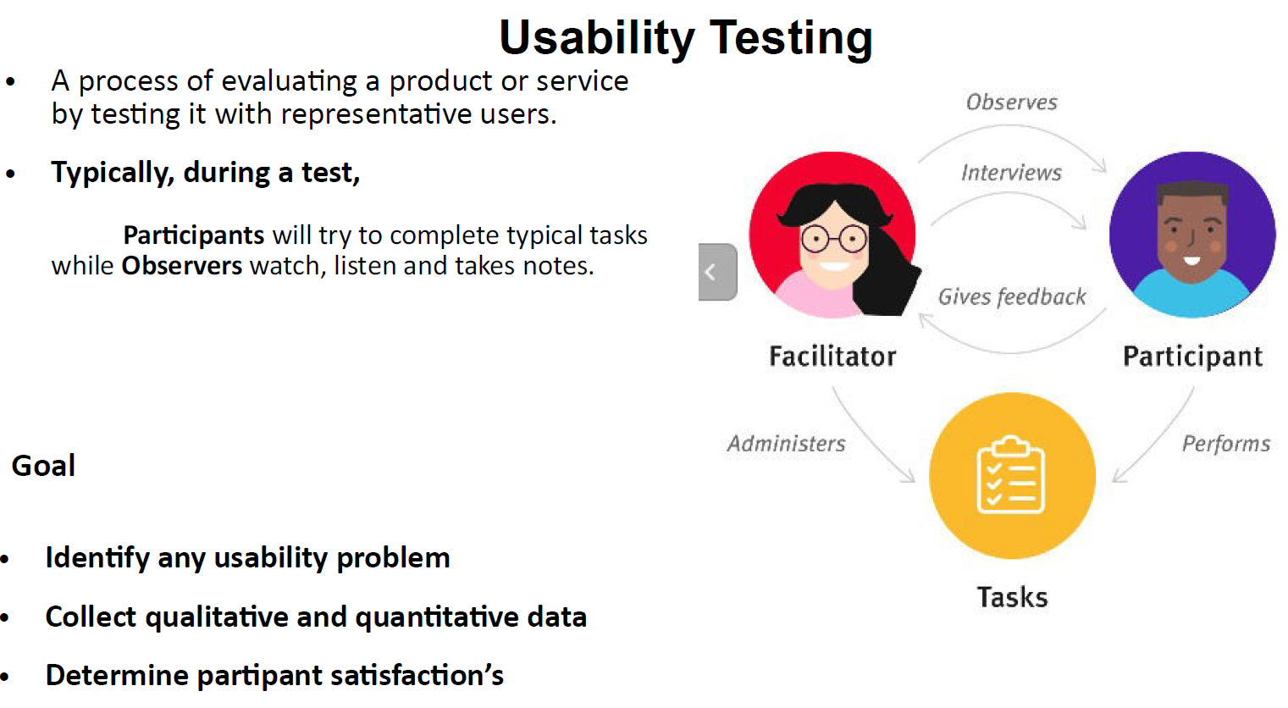

Slide 63
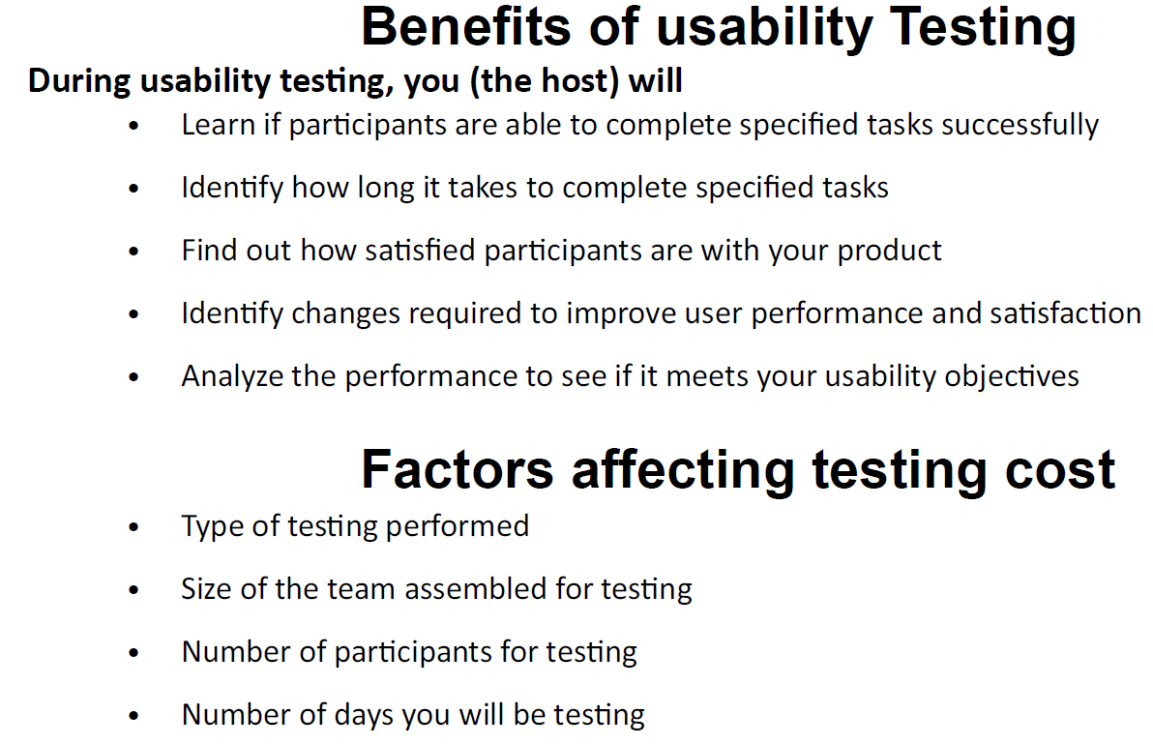

Slide 64
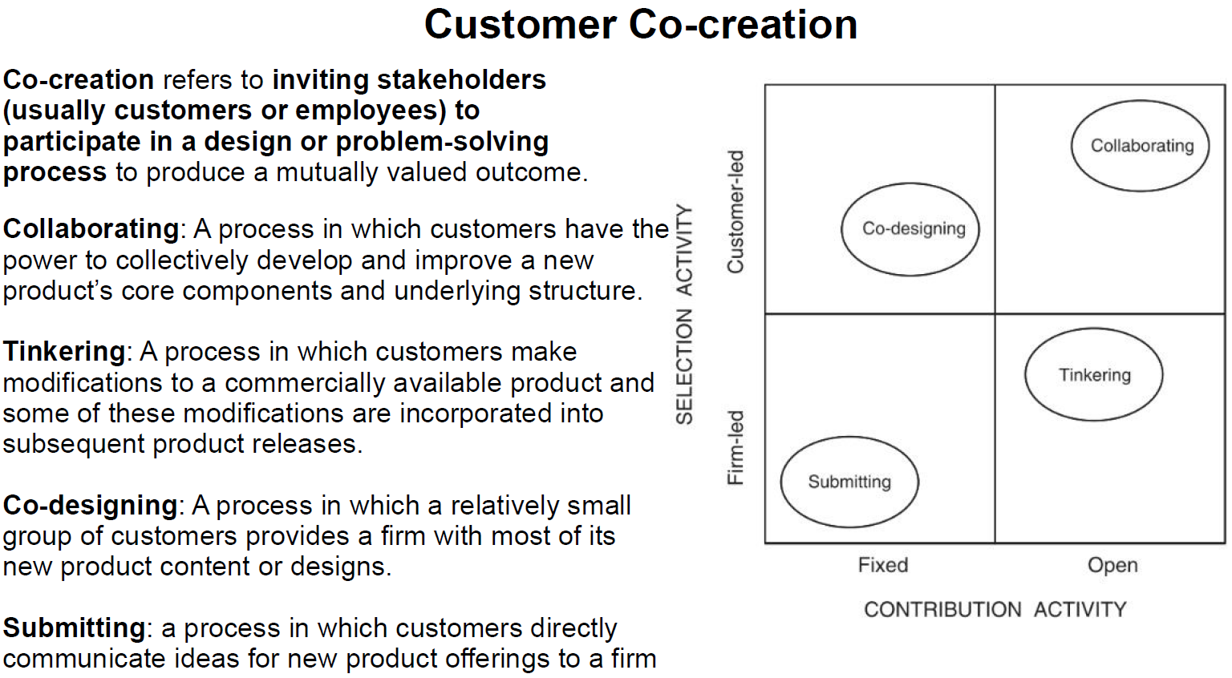

Slide 65
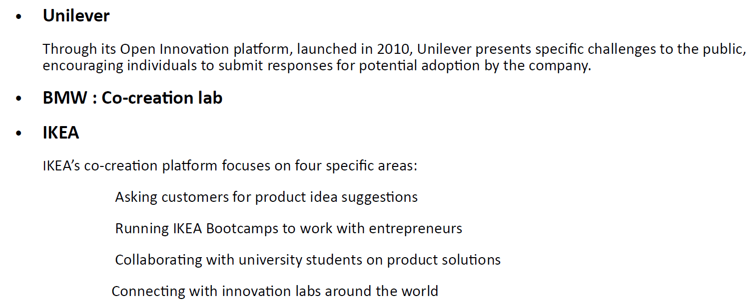

Slide 66
